Slide 1
Optimizing Facility Management through Advanced SQL Analytics
Project by Yelyzaveta Ben

Slide 2
Project overview
In today’s data-driven world, organizations seek actionable insights from their data to enhance decision-making and operational efficiency. Our project, Optimizing Facility Management through Advanced SQL Analytics, exemplifies how sophisticated SQL queries can drive strategic improvements within facility management. By utilizing complex SQL techniques, this project aims to transform raw data into valuable insights, aiding in better management and strategic planning.
The project focuses on analyzing data from three key tables: bookings, facilities, and members. The bookings table tracks facility usage, detailing each booking’s time, duration, and associated member. The facilities table holds information about each facility’s cost structures and maintenance expenses. Finally, the members table provides details on member demographics and referral sources.

Slide 3
Dataset
bookings
bookid
facid
memid
starttime
slots
facilities
facid
name
membercost guestcost initialoutlay monthlymaintenance
members
memid
surname
firstname
address
zipcode
telephone reccomendedby joindate

Slide 4
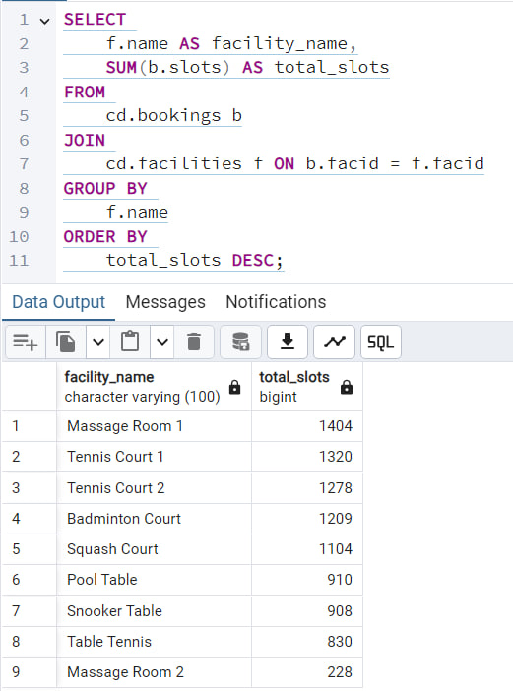
Task 1: Identifying the Most Popular Facility by Usage
The goal is to determine which facility has the highest total number of slots booked. This task involves summing bookings across all facilities and ranking them to identify the most popular one. It showcases skills in data aggregation and ranking, and the results can inform resource allocation and future facility planning.

Slide 5
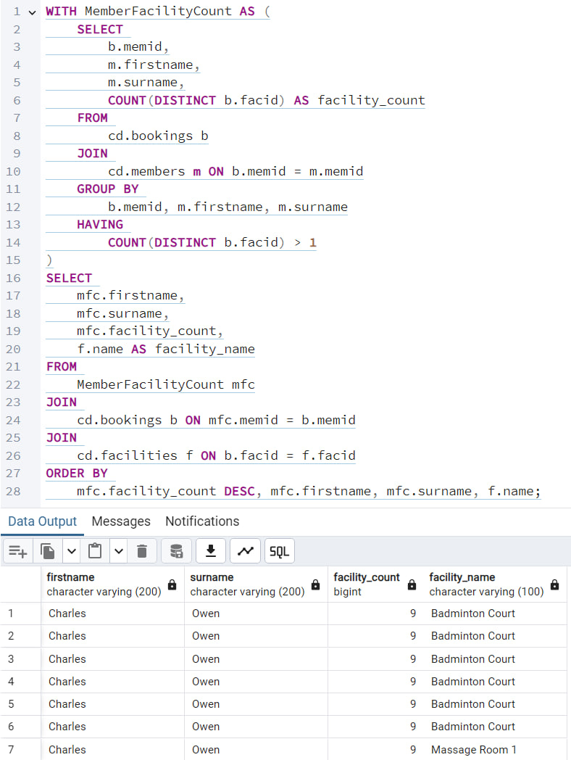
Task 2: Analyzing Members Who Booked Multiple Facilities
This task identifies members who have booked more than one different facility and details their usage. It requires using advanced SQL techniques to count distinct values, group results, and manage complex joins. The insights help in understanding member preferences and behaviors, which can support targeted marketing and personalized services.

Slide 6
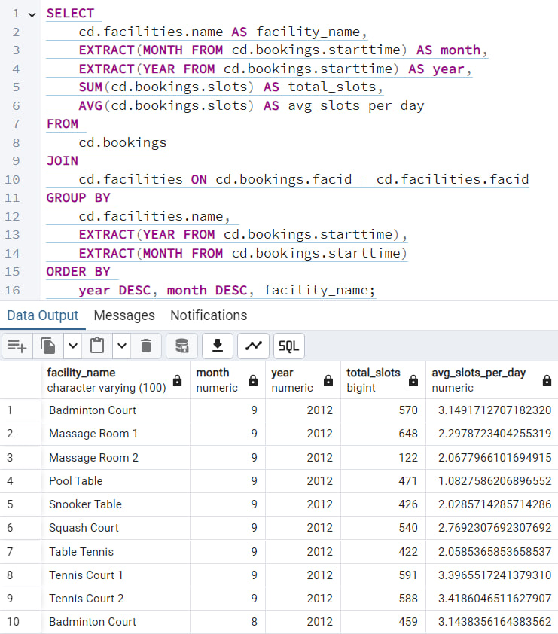
Task 3: Facility Utilization Analysis
This task involves calculating the total and average slots booked for each facility on a monthly basis over the last six months. It showcases your ability to work with time-series data, perform aggregations, and use date functions. The analysis helps in understanding facility usage patterns, which can inform operational decisions such as staffing and maintenance scheduling.

Slide 7
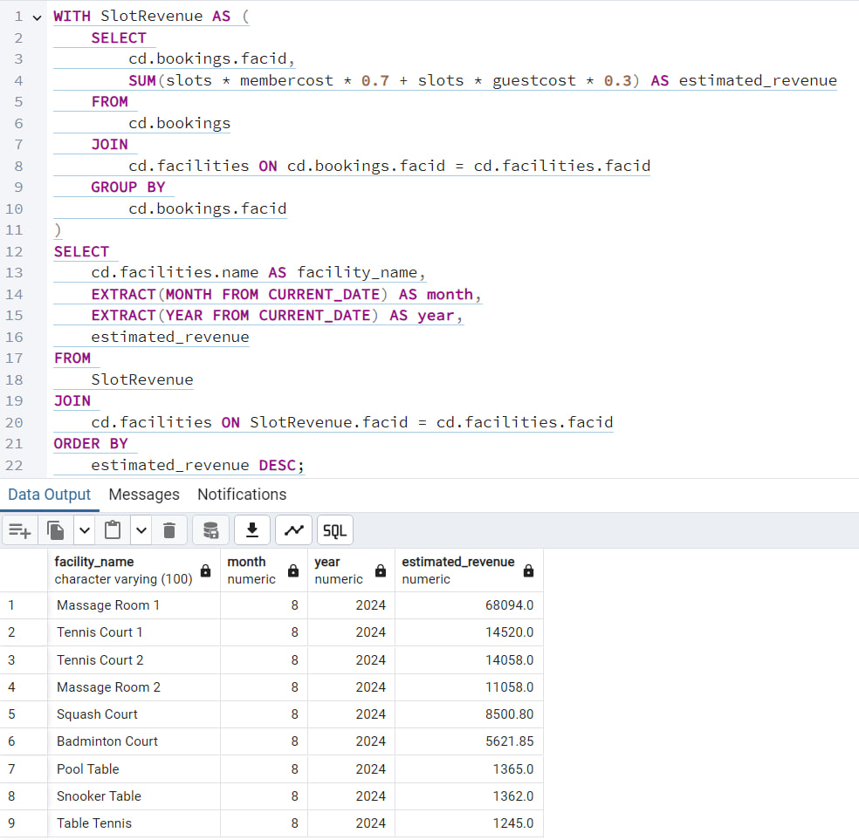
Task 4: Revenue Forecasting
Here, the goal is to estimate the revenue generated from each facility, factoring in member and guest costs. By applying a hypothetical distribution of bookings between members and guests, this task demonstrates the ability to perform complex financial calculations and scenario analysis. The insights can guide pricing strategies and promotional efforts.

Slide 8
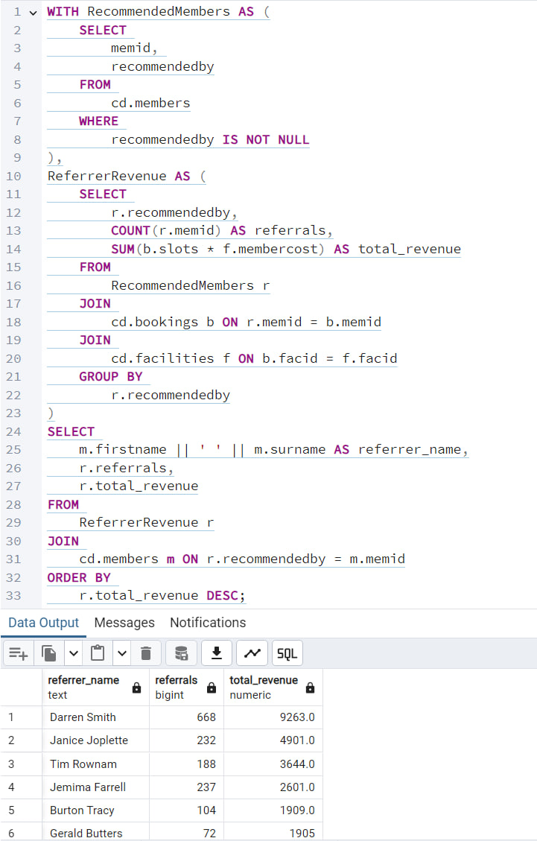
Task 5: Member Referral Impact Analysis
This task focuses on identifying influential members based on their ability to recommend new members, and calculating the revenue generated from these referrals. It highlights skills in using joins and aggregations to track relational data. Understanding the impact of member referrals can help in developing reward programs and enhancing customer relationship management.

Slide 9
Results
The project Optimizing Facility Management through Advanced SQL Analytics has successfully demonstrated the power of advanced SQL techniques in deriving actionable insights from complex data sets. Through meticulous analysis of facility booking patterns, financial performance, and member behaviors, the project has provided valuable recommendations that are poised to enhance operational efficiency and strategic planning.
Facility Utilization Analysis revealed key usage patterns, highlighting peak booking periods and identifying which facilities are most frequently utilized. This information is critical for optimizing resource allocation and scheduling maintenance, ensuring that facilities are effectively managed to meet demand.
Revenue Forecasting offered a comprehensive view of potential revenue streams by calculating the estimated income from each facility. By understanding the financial implications of member and guest bookings, the organization can adjust pricing strategies and promotional activities to maximize revenue.
The Member Referral Impact Analysis shed light on the effectiveness of referral programs, showing how influential members drive new memberships and contribute to revenue growth. This insight is instrumental for refining marketing strategies and recognizing high-impact referrers who enhance the membership base.
Identifying the Most Popular Facility by Usage showcased the facilities that are most in demand. This ranking is essential for strategic planning, resource allocation, and potentially expanding high-traffic facilities to accommodate growing demand.
Finally, the analysis of Members Who Booked Multiple Facilities provided insights into member preferences and booking behaviors.

